Slide 1
LHC Incident
Eric Prebys, FNAL

Slide 2
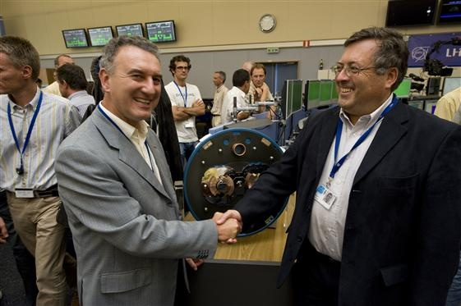
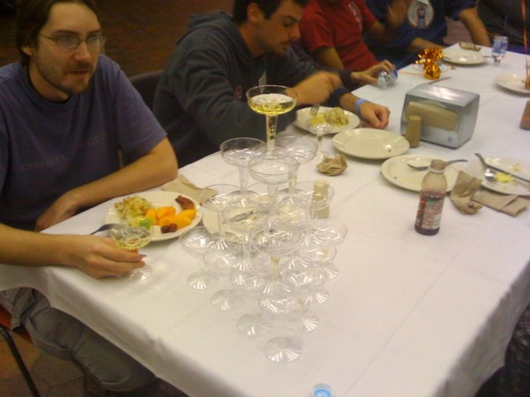
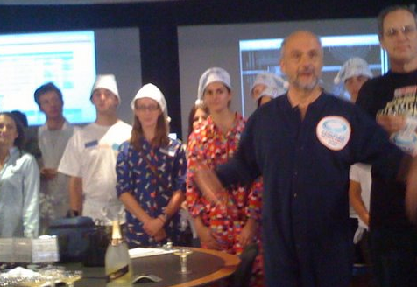
Sept 10, 2008: LHC Startup
9:35 – First beam injected
9:58 – beam past CMS to point 6 dump
10:15 – beam to point 1 (ATLAS)
10:26 – First turn!
…and there was much rejoicing

Slide 3
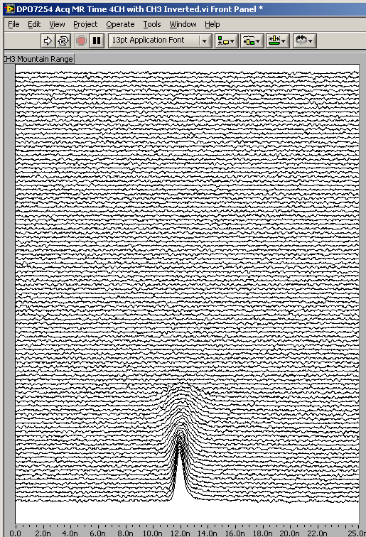
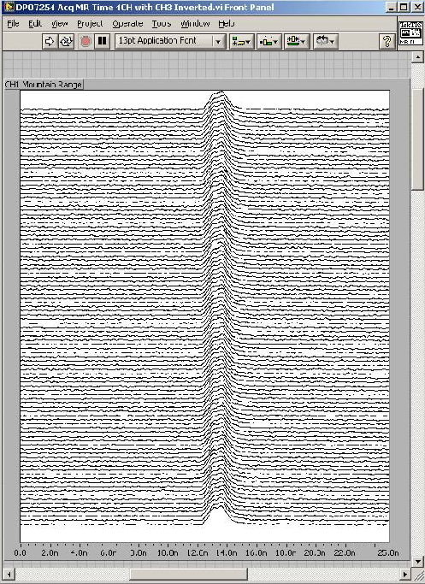
After initial circulation: captured beam
Turn Number
Time
Everything was going great until something very bad happened on September 19th
Initially, CERN kept a tight lid on news

Slide 4
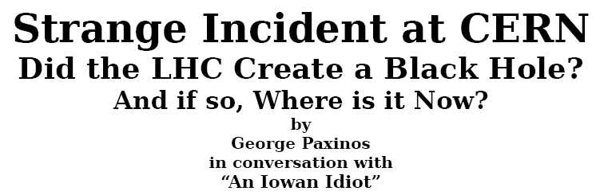
Nature abhors a (news) vacuum…
Italian newspapers were very poetic (at least as translated by “Babel Fish”):
"the black cloud of the bitterness still has not been dissolved on the small forest in which they are dipped the candid buildings of the CERN"
“Lyn Evans, head of the plan, support that it was better to wait for before igniting the machine and making the verifications of the parts.“*
Or you could Google “What really happened at CERN”:
**
* “Big Bang, il test bloccato fino all primavera 2009”, Corriere dela Sera, Sept. 24, 2008
**http://www.rense.com/general83/IncidentatCERN.pdf

Slide 5
What (really) really happened on September 19^{th*}
Sector 3-4 was being ramped to 9.3 kA, the equivalent of 5.5 TeV
All other sectors had already been ramped to this level
Sector 3-4 had previously only been ramped to 7 kA (4.1 TeV)
At 11:18AM, a quench developed in the splice between dipole C24 and quadrupole Q24
Not initially detected by quench protection circuit
Power supply tripped at .46 sec
Discharge switches activated at .86 sec
Within the first second, an arc formed at the site of the quench
The heat of the arc caused Helium to boil.
The pressure rose beyond .13 MPa and ruptured into the insulation vacuum.
Vacuum also degraded in the beam pipe
The pressure at the vacuum barrier reached ~10 bar (design value 1.5 bar). The force was transferred to the magnet stands, which broke.

Slide 6
Pressure forces on SSS vacuum barrier
Vacuum
Pressure
1 bar
1/3 load on cold mass (and support post)
~23 kN
1/3 load on barrier
~46 kN
Total load on 1 jack ~70 kN
V. Parma

Slide 7
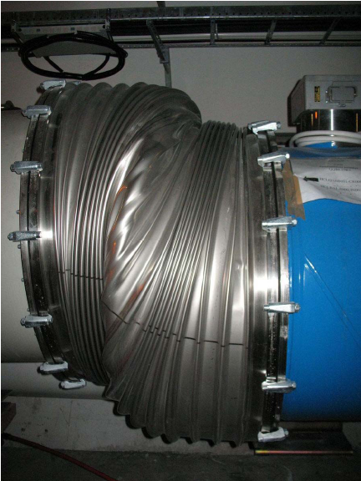
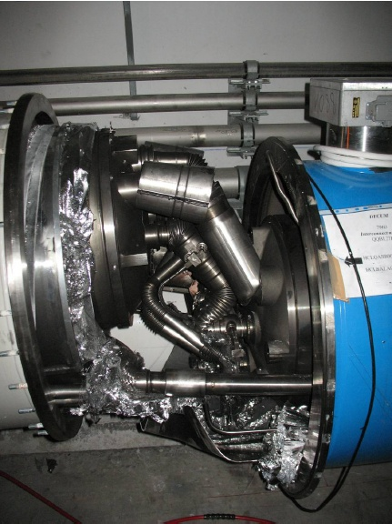
Collatoral damage: magnet displacements
QQBI.27R3

Slide 8
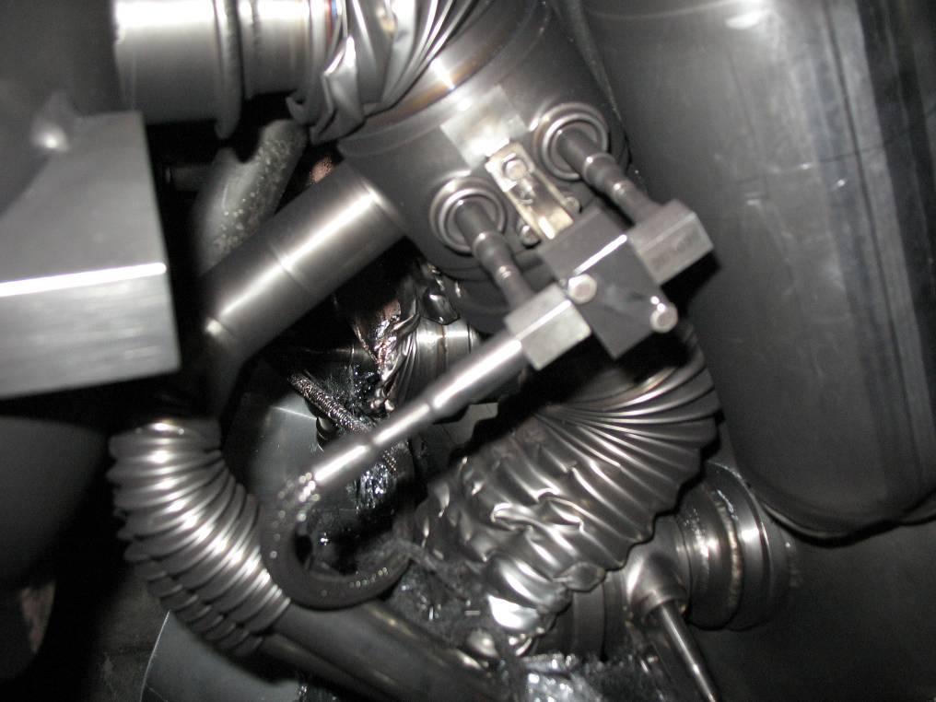
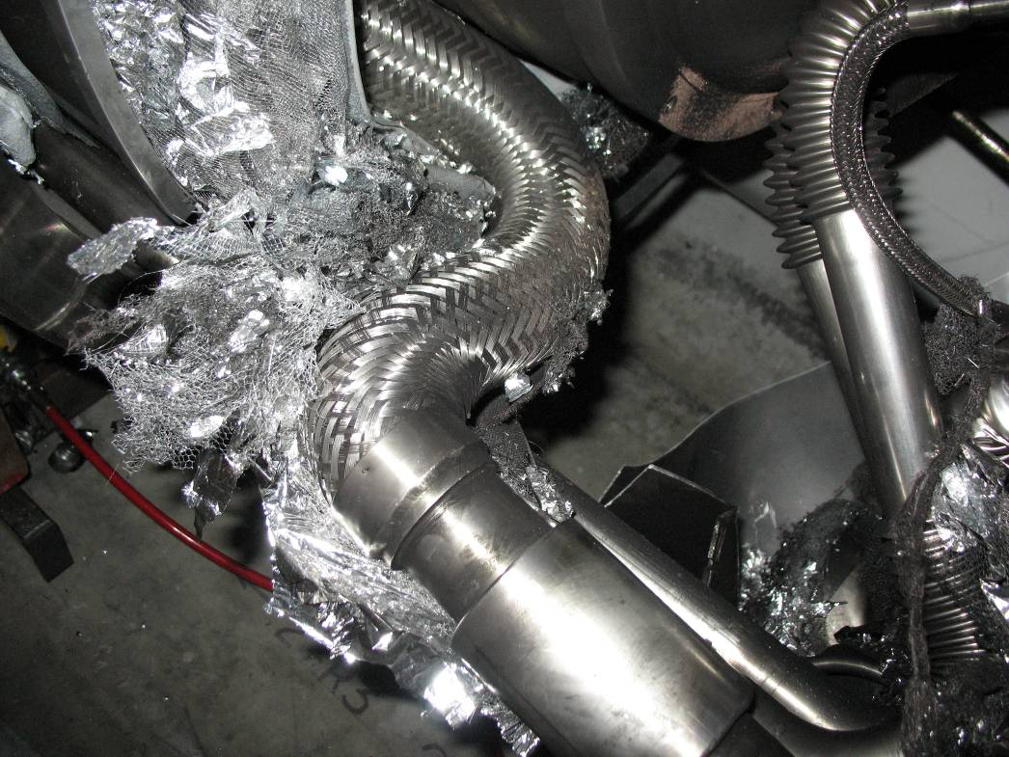
Collatoral damage: magnet displacements
QQBI.27R3
N line
QQBI.27R3
V2 line

Slide 9
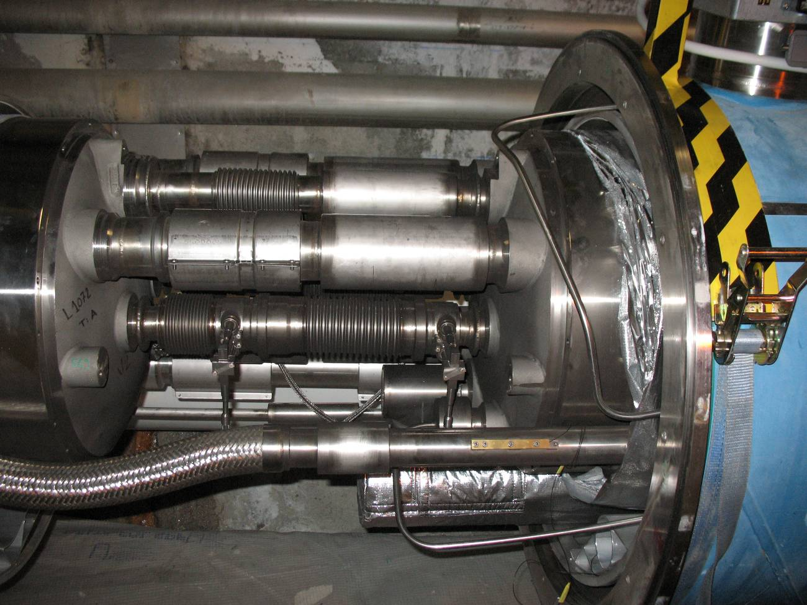
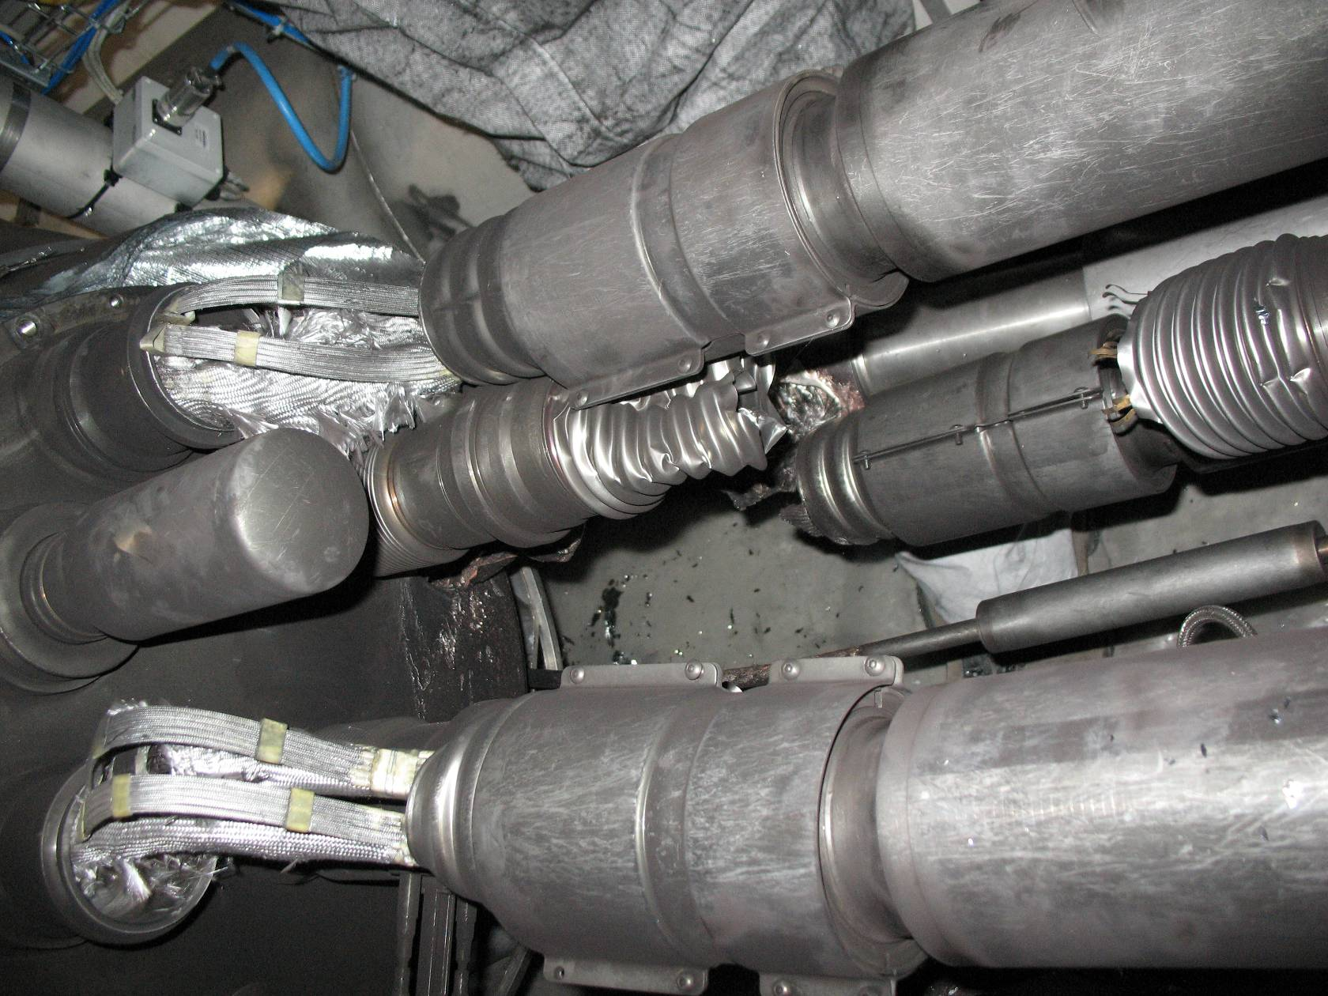
Collateral damage: magnet displacements
QBQI.27R3
Bellows torn open
QBBI.B31R3
Extension by 73 mm

Slide 10
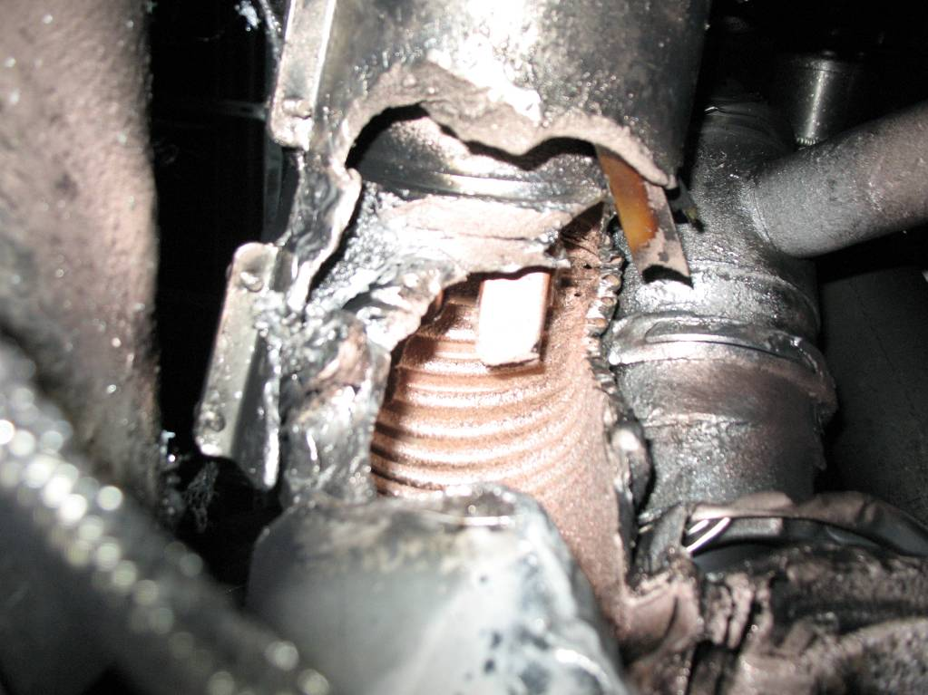
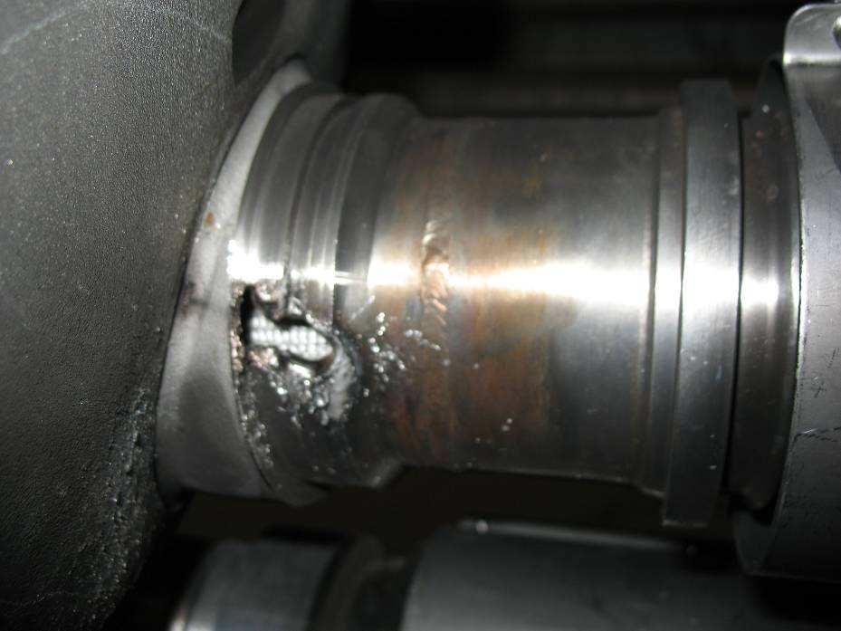
Collateral damage: secondary arcs
QBBI.B31R3 M3 line
QQBI.27R3 M3 line

Slide 11
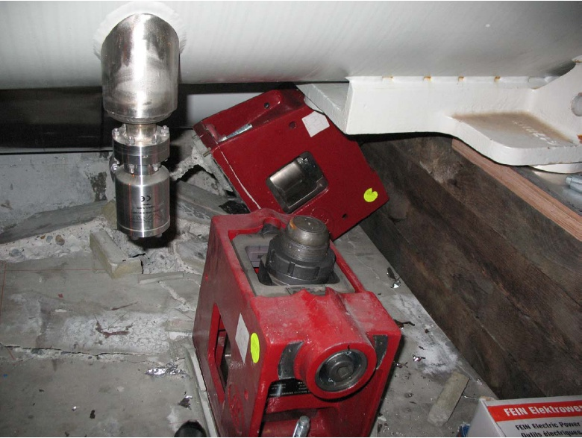
Collateral damage: ground supports

Slide 12
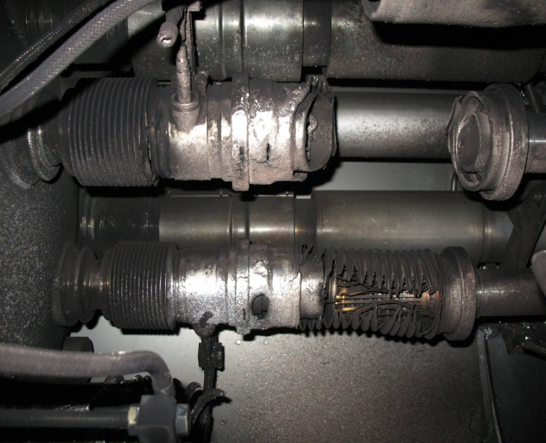
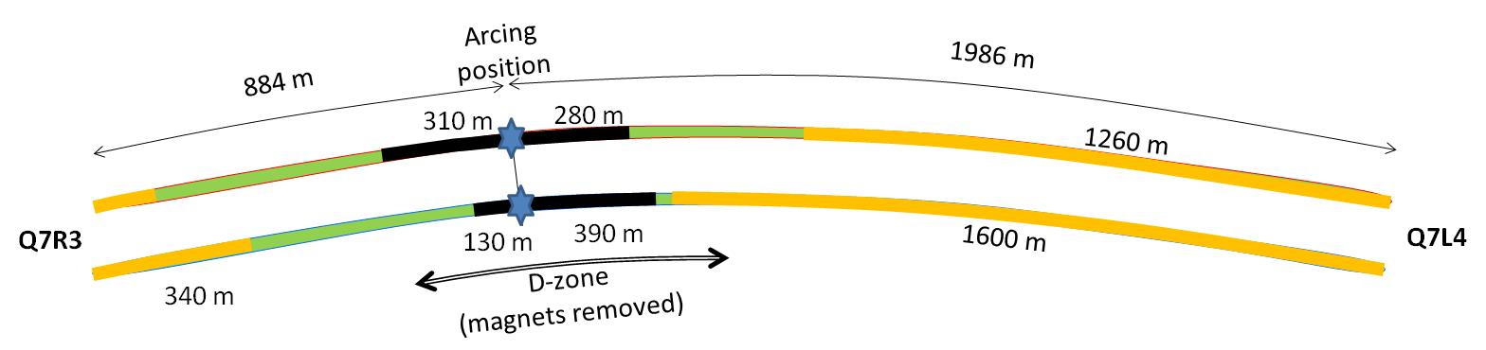

Collateral damage: Beam Vacuum
Arc burned through beam vacuum pipe
clean
MLI
soot
The beam pipes were polluted with thousands of pieces of MLI and soot, from one extremity to the other of the sector
LSS3
LSS4
OK
Debris
MLI
Soot

Slide 13
Replacement of magnets
15 Quadrupoles (MQ)
1 not removed (Q19)
14 removed
8 cold mass revamped (old CM, partial de-cryostating for cleaning and careful inspection of supports and other components)
6 new cold masses
In this breakdown there is consideration about timing (quad cryostating tales long time; variants problems).
42 Dipoles (MBs)
3 not removed (A209,B20,C20)
39 removed
9 Re-used (old cold mass, no decryostating –except one?)
30 new cold masses
New cold masses are much faster to prepare than rescuing doubtful dipoles)

Slide 14
Important questions about Sept. 19
Why did the joint fail?
Inherent problems with joint design
No clamps
Details of joint design
Solder used
Quality control problems
Why wasn’t it detected in time?
There was indirect (calorimetric) evidence of an ohmic heat loss, but these data were not routinely monitored
The bus quench protection circuit had a threshold of 1V, a factor of >1000 too high to detect the quench in time.
Why did it do so much damage?
The pressure relief system was designed around an MCI Helium release of 2 kg/s, a factor of ten below what occurred.

Slide 15
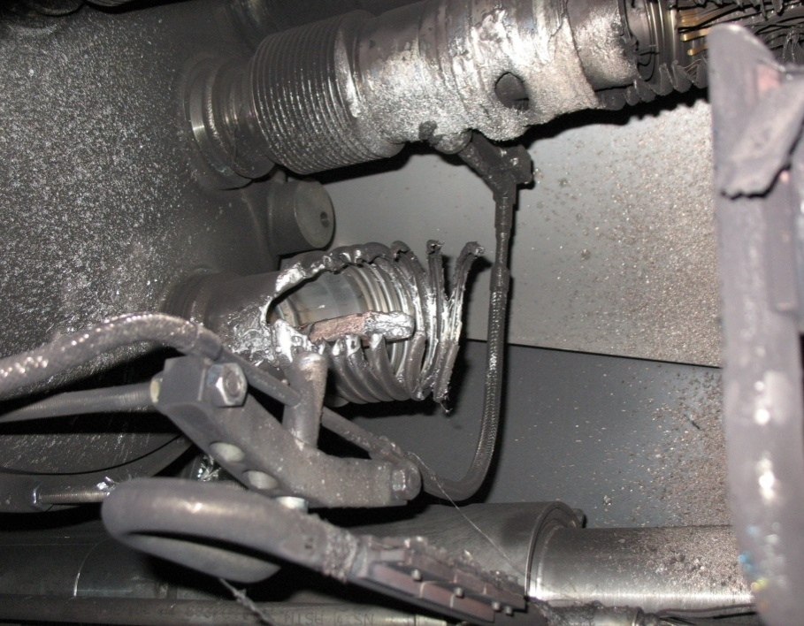
What happened?
Theory: A resistive joint of about 220 nΩ with bad electrical and thermal contacts with the stabilizer
No electrical contact between wedge and U-profile with the bus on at least 1 side of the joint
No bonding at joint with the U-profile and the wedge
Loss of clamping pressure on the joint, and between joint and stabilizer
Degradation of transverse contact between superconducting cable and stabilizer
Interruption of longitudinal electrical continuity in stabilizer
Problem: this is where the evidence used to be
A. Verweij

Slide 16
Improved quench protection*
Old quench protection circuit triggered at 1V on bus.
New QPS triggers at .3 mV
Factor of 3000
Should be sensitive down to 25 nOhms (thermal runaway at 7 TeV)
Can measure resistances to <1 nOhm
Concurrently installing improved quench protection for “symmetric quenches”
A problem found before September 19th
Worrisome at >4 TeV

Slide 17
Improved pressure relief*
New configuration on four cold sectors: Turn several existing flanges into pressure reliefs (while cold). Also reinforce stands to hold ~3 bar
New configuration on four
warm sectors: new flanges
(12 200mm relief flanges)
(DP: Design Pressure)
L. Tavian

Slide 18
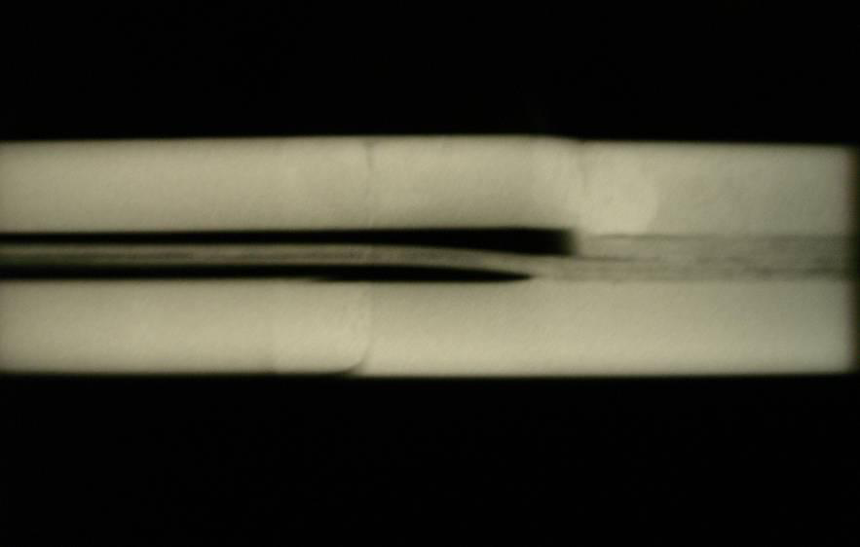
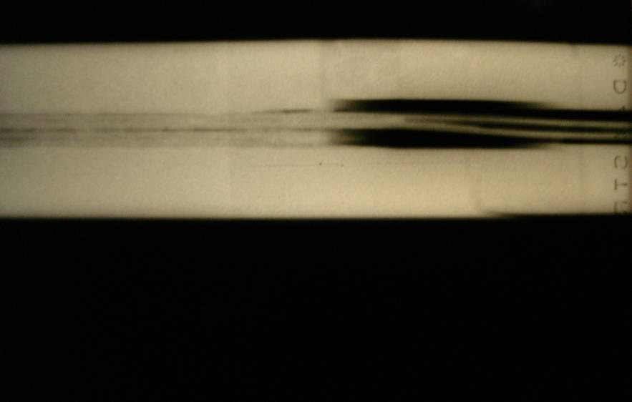
Bad surprise
With new quench protection, it was determined that joints would only fail if they had bad thermal and bad electrical contact, and how likely is that?
Very, unfortunately ⇒ must verify copper joint
Have to warm up to at least 80K to measure Copper integrity.
Solder used to solder joint had the same melting temperature as solder used to pot cable in stablizer
⇒Solder wicked away from cable

Slide 19
Complete Repair (2013-2015)
All (10,000!) individual joints were rebuilt
Clamped
Inspected
Improved pressure relief was installed to handled “Maximum Credible Incident” (MCI)
In which both the quadrupole and dipole Helium lines were burned through.
After 2015 turn on, “smooth sailing”.

